Slide 1
Mechanisms and Robotics DE ES ZG561
Lecture-13

Slide 2
Contents
Sensors
Types
Working
Applications in Robotics

Slide 3
Sensors
A Sensor converts the physical parameter (for example: temperature, pressure, Velocity, Force, etc.) into a signal which can be measured electrically.
Criteria to choose a Sensor
There are certain features which have to be considered when we choose a sensor. They are as given below:
Accuracy- The true value of the variable that can be sensed with no systematic positive or negative errors
Repeatability /Precision- The reading that varies is repeatedly measured under the same environment.
Range - Measurement limits of sensor.
Resolution - Smallest increment detected by the sensor.
Reliability – Maintaining functionality and accuracy after prolonged use and use under different conditions
Environmental condition - usually has limits for temperature/ humidity
Calibration - Essential for most of the measuring devices as the readings changes with time.
Cost- The cost to purchase install and operate the sensor should be as low as possible.

Slide 4
Sensor Types
Internal Sensors
Position
Velocity
Acceleration
Force
External Sensors
Contact Type
Limit Switches
Pneumatic Switches
Piezoelectric Sensors
Pressure transducers
Non Contact Type
Proximity Sensors
Hall-Effect Sensors
Microwave Sensors
Ultrasonic Sensors
Laser Sensors
Vision Sensors

Slide 5
Internal Sensors
Position
Incremental Encoder
Absolute Encoder
Potentiometer
LVDT
Velocity
All Position Sensors
Tachometer
Hall Effect Sensor
Force
Strain Gauges
Piezoelectric Sensors
Acceleration
All Force Sensors

Slide 6
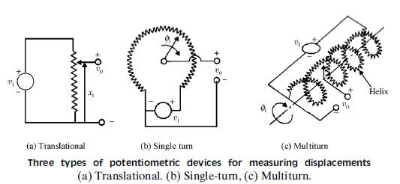
Potentiometer
Limitations
Analog Device
Possible Friction and noise
Less Accurate

Slide 7
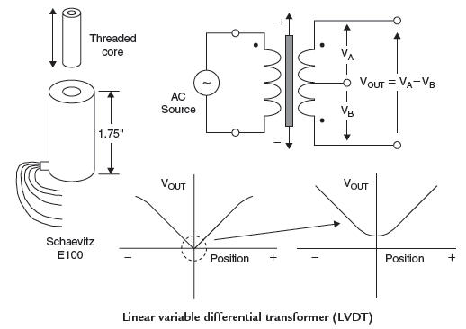
LVDT
The LVDT is a position-to-electrical sensor whose output is proportional to the position of a movable magnetic core. The core moves linearly inside a transformer consisting of a center primary coil and two outer secondary coils wound on a cylindrical form.
It should be noted that the LVDT concept can be implemented in rotary form, in which case the device is
called a rotary variable differential transformer (RVDT).

Slide 8
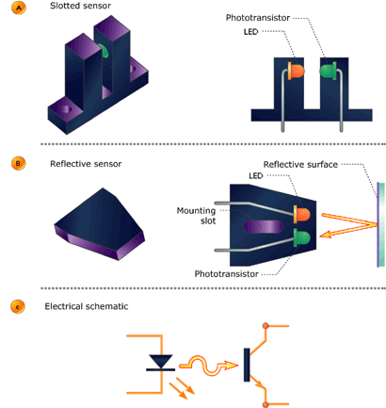
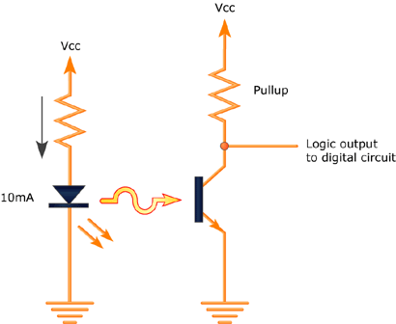
Optical Sensors

Slide 9
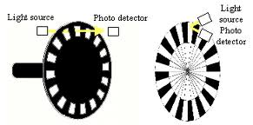
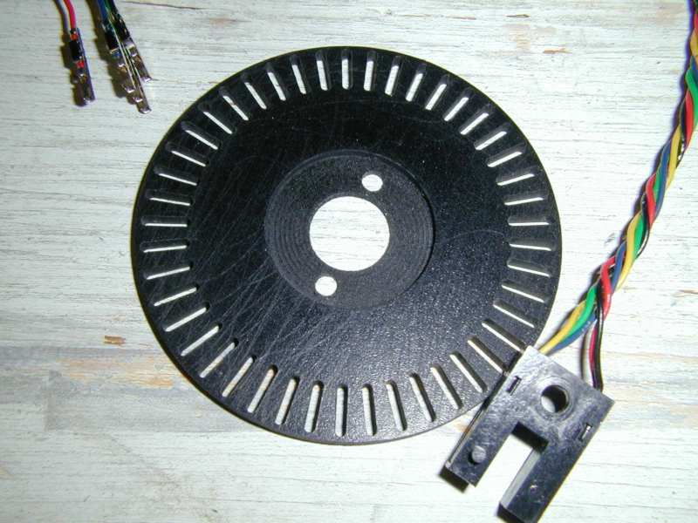
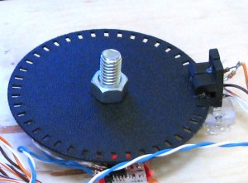
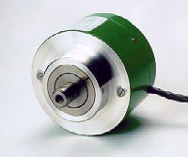
Optical Encoder (Incremental)
Limitations:
When Switched OFF, the position is not stored in memory
Homing operation needs to be performed during starting.

Slide 10

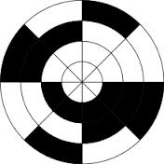
Optical Encoder (Absolute)
3-Track Encoder Disc
8-Track Encoder Disc

Slide 11
Proximity and Range Sensors
Proximity and Range sensors detect the presence of objects without physical contact.
Proximity Sensors detect the presence of an object
Range sensors detect the exact distance of the object from the given point.
One practical use of proximity sensor in robotics is to detect the presence or absence of a work part.

Slide 12
Range Sensors
A Range sensor measures the distance from a reference point to objects in the field of operation of the sensor.
Range sensors are used in robot navigation and obstacle avoidance.
Range sensing Techniques
Triangulation technique
Structured Lighting approach
Time of flight range finder

Slide 13
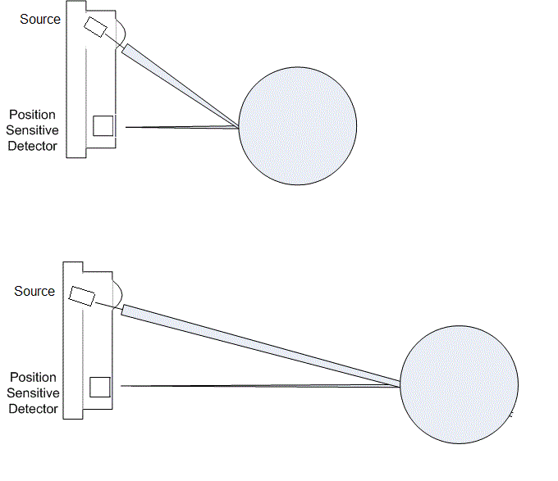
Triangulation Technique
An Object is illuminated by a narrow beam of light which is swept over the surface.
The detector captures the reflected light beam
The distance between the source and the detector is known
The angle at which the light travels from the source is known.
The distance of the object can be calculated using trigonometric relations.

Slide 14
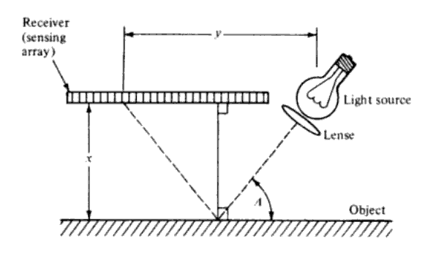
Optical Proximity Sensors
By reflecting a light beam off the surface of the object, the location of the object can be determined from the position of its reflected beam on the sensor array

Slide 15
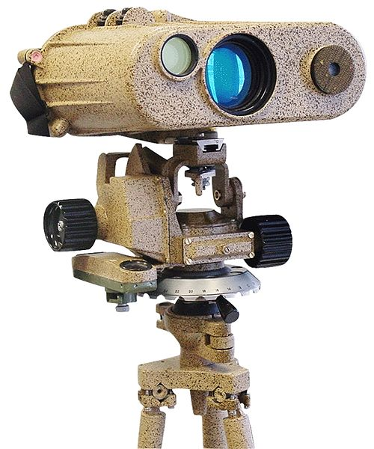
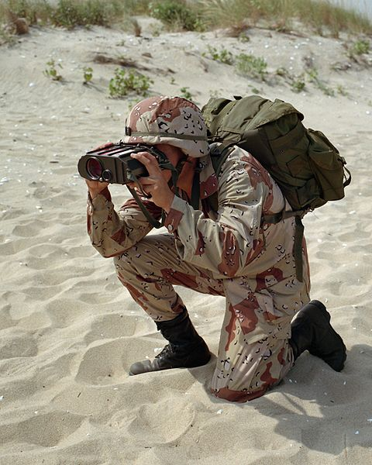
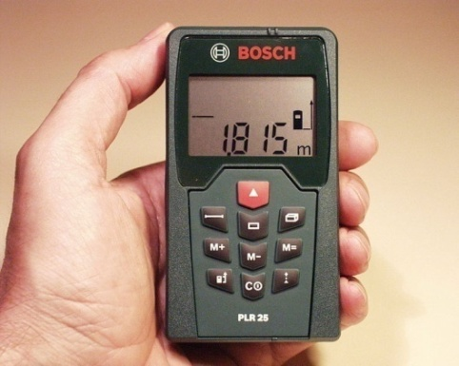
Time of Flight Ranger Finder
Laser Rangefinder
A laser rangefinder is a device which uses a laser beam to determine the distance to an object.
The most common form of laser rangefinder operates on the time of flight principle by sending a laser pulse in a narrow beam towards the object and measuring the time taken by the pulse to be reflected off the target and returned to the sender.
Due to the high speed of light, this technique is not appropriate for high precision sub-millimeter measurements, where triangulation and other techniques are often used.

Slide 16
Proximity Sensors
Inductive
Capacitive
Ultrasonic
Magnetic

Slide 17
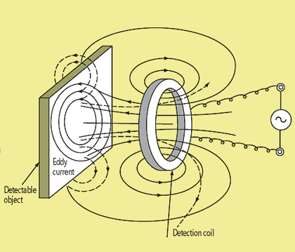
Inductive Sensor
Sensors based on a change of inductance due to the presence of a metallic object are among the most widely used industrial proximity sensors.
The effect of bringing the sensor in close proximity to a ferromagnetic material causes a change in the position of the flux lines of the permanent magnet
An oscillator and a detection coil produce a magnetic field that produces eddy current in a metallic object.
The eddy currents generate a magnetic field that influences the field produced by the sensor’s detection coil

Slide 18
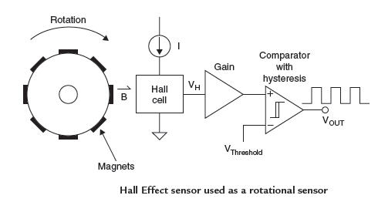
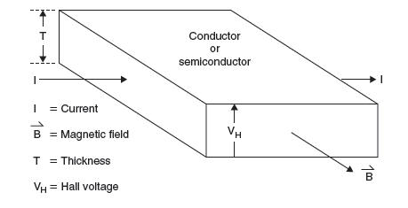
Hall Effect Magnetic Sensors
If a current flows in a conductor (or semiconductor) and there is a magnetic field present which is perpendicular to the current flow, then the combination of current and magnetic field will generate a voltage perpendicular to both. This phenomenon is called the Hall Effect , was discovered by E. H. Hall in 1879.

Slide 19
Capacitive Sensors
Inductive and hall effect sensors detect only ferromagnetic materials.
Capacitive sensors are capable of detecting all solid and liquid materials
Works based on detecting a change in capacitance induced by a surface that is brought near the sensing element.
The sensing element is a capacitor composed of a sensing electrode and a reference electrode.

Slide 20
Ultrasonic Sensors
Ultrasonic sensors measure the distance or presence of target objects by sending a pulsed ultrasound wave at the object and then measuring the time of the sound echo to return.
Knowing the speed of sound the sensor can determine the distance of the object. (Both Proximity and Range sensor)

Slide 21
Pneumatic Sensors
Pneumatic sensors involve the use of compressed air in detecting the presence of objects.
Low pressure air is allowed to escape though a port in front of the sensor.
If there is no obstacle, the air escapes thereby reducing the pressure in the outlet port.
If there is an obstacle, the air cannot easily escape and the pressure increases at the outlet port.
The increase in pressure can be used to determine the distance of the obstacle from the sensor.
Small displacements can be measured using such sensors.

Slide 22
Tactile Sensors
Tactile sensors are devices that indicate contact between themselves and some other solid object.
They can be classified into
Touch Sensors (give binary output, whether the object is present or not)
Force Sensors (Indicate the magnitude of the contact forces)

Slide 23
Touch Sensors
Examples:
Micro Switches
Limit Switches
Applications:
Design of Interlock systems in Robotics.
Inspection and measurement of dimensions of a work part by the Robot.

Slide 24
Force Sensors
Force Sensing Wrist
Maltese-Cross Force Sensor (force Torque Sensor or Wrist force sensor)

Slide 25
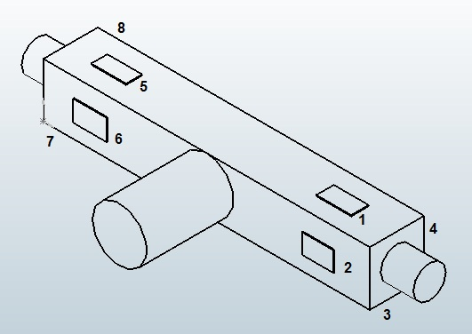
Force Sensing Wrist

Slide 26
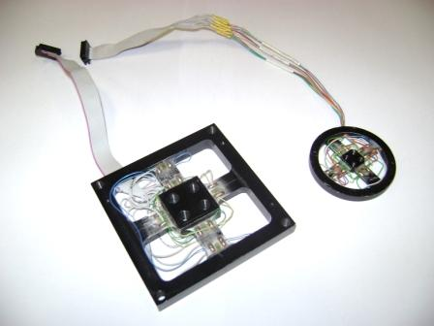
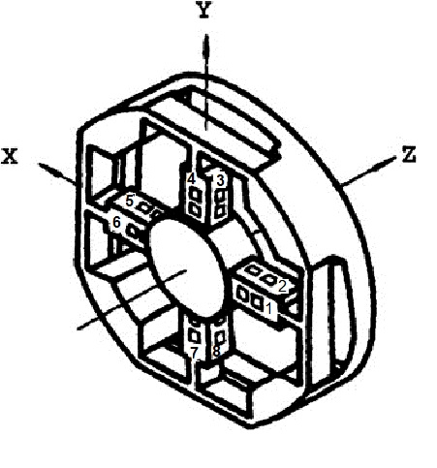
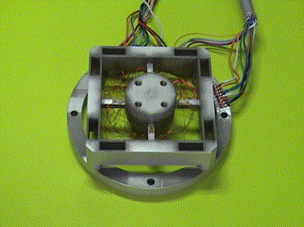
Maltese-Cross Force Torque Sensor
In 3D space there are 3 forces and 3 moments.
A force sensor is usually made having four arms, each of which responds to two forces.

Slide 27
Joint Sensing
If the robot uses DC servomotors, the torque exerted by the motors is proportional to the current flowing though the armature.
By measuring the voltage drop across the armature the torque can be calculated.
Limitations
The output is obtained in Joint space.
The forces at the tool space need to be calculated

Slide 28
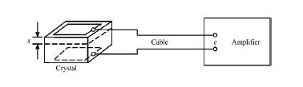
Piezo Electric Sensor
Piezoelectric materials generate an electric potential when mechanically strained, and conversely an electric potential can cause physical deformation of the material.

Slide 29
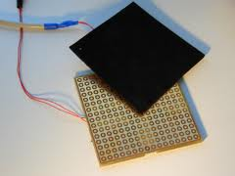
Tactile array sensors
It is a special type of force sensor composed of a matrix of force sensing elements.

Slide 30
Tactile Array Sensors using Sensitive skin
A conductive elastomer is a rubberlike material whose electrical conductivity changes when compressed.
The elastomer is laid over a printed circuit board etched with 16 pairs of concentric rings.
Each pair of rings form a sensing element.
When the pressure is applied on the elastomer current is conducted from the inner to the outer rings.
Pattern recognition techniques are used to detect the edge or points or other shapes.

Slide 31
Slip Sensors
The function of slip sensing is to determine whether an object is sliding out of an artificial hand or robot gripper. If an object starts to slide out of a pair of grippers, the gripping force is not strong enough. A robot can be prevented from dropping an object if the pressure of its grip is increased until all slipping stops.
Slip sensing is based on detecting the first minute movement of the object held in the grippers.
Three methods are currently available to detect movement:
The first is to press a needle against an object that oscillates when the object moves.
The second method is to translate the object's motion into another form of displacement with a cylindrical roller or a sphere.
The third method pressure distribution of the fingers with pressure sensors.

Slide 32
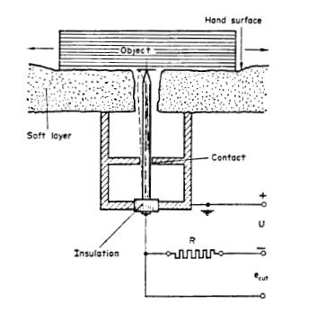
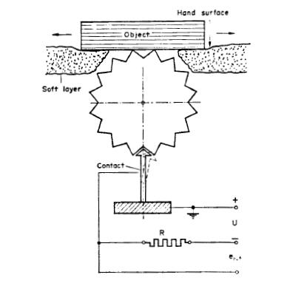
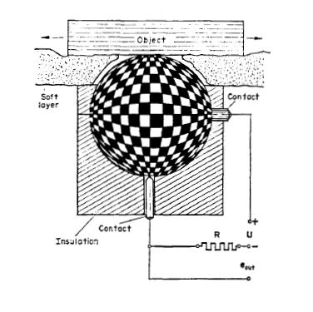
Slip Sensors
Needle Type Slip sensor
Ratchet Type Slip Sensor
Ball Type Slip Sensor
Working:
Magnets can be attached to the ball and a coil could be energized.
Optical path could be interrupted by the attachments to the ball or roller.

Slide 33
Uses of Sensors
The Major uses of sensors in industrial robotics and other automated manufacturing systems can be divided into four basic categories,
Safety Monitoring
Interlocks in work-cell control
Part Inspection for quality control
Determining positions and related information about objects in the robot cell.
Work Part Identification
Identifying the position and orientation of parts in the work cell.

Slide 34
Safety Sensors
Three Levels of Safety
Level 1 – Perimeter Penetration.
Level 2 – Intruder detection in the work cell.
Level 3 – Intruder detection in the work volume.
Methods:
Pressure Sensitive Floor mats → Level 1 and Level 2
Light Curtains → Level 1
Proximity Sensors on the robotic arm → Level 3
Monitoring System Reaction:
Complete Shutdown of the robot
Activation of Warning Alarms
Reduction of speed of the robot to a ‘safe’ level.
Directing the robot to move its arm away from the intruder to avoid collision. (Obstacle avoidance)
Directing the robot to perform tasks in other regions of the work cell.

Slide 35
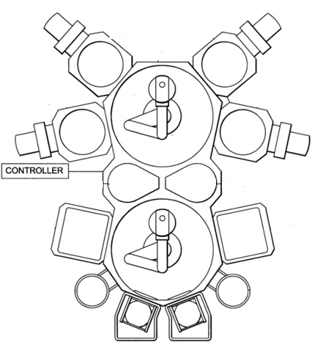
Interlocks in work-cell control
Coordinating various activities in the work cell.
Work Cell Activities
Sequential Activities
Simultaneous activities
Activities are controlled by a work cell controller or a programmable controller.
The functions performed by a work cell controller
Sequence Control
Operator Interface
Safety Monitoring

Slide 36
Machine Vision
Other Names:
Computer Vision
Artificial Vision
Applications:
Inspection
Selection of Parts
Part orientation
Part Identification
Requirements:
Low-cost
Rapid response time (needed for robot or manufacturing applications)

Slide 37
Sensing and digitizing data
Involves input of vision data by means of a camera focused on the target location.
Special lighting techniques are used to obtain an image of sufficient contrast for the processing.
The image captured by the camera is digitized and stored in the computer.
The digital image is called the frame of vision data and is created by a device called frame grabber.
The digital image is created at the rate of 30 frames per second.
The frames consist of a matrix of data representing projections of the scene sensed by the camera.
The elements of the matrix are called picture elements or pixels.

Slide 38
Image
An image refers to a 2D light intensity function f(x,y), where (x,y) denote spatial coordinates and the value of f at any point (x,y) is proportional to the brightness or gray levels of the image at that point.

Slide 39
Lighting
Good illumination reduces the complexity of the image processing algorithms required.
Lighting Devices
Diffuse surface devices – (Fluorescent lamps)
Condenser projectors – (Transforms expanding light in to a condensing light source)
Flood spot projectors (Used to illuminate surface areas)
Collimators (Used to provide parallel beam of light)
Imagers (Create an image of the object on a screen)

Slide 40
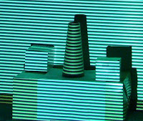

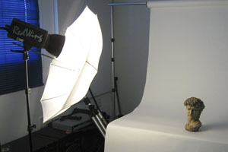
Lighting Techniques
Front Illumination
Dark field - Dark background
Bright field – Angular lighting and camera in line with reflected rays
Front imager – uses structured lighting
Rear Illumination – used to read silhouette of objects
Condenser
Collimator
Structured lighting
Silhouette

Slide 41
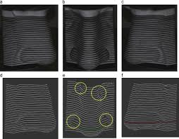
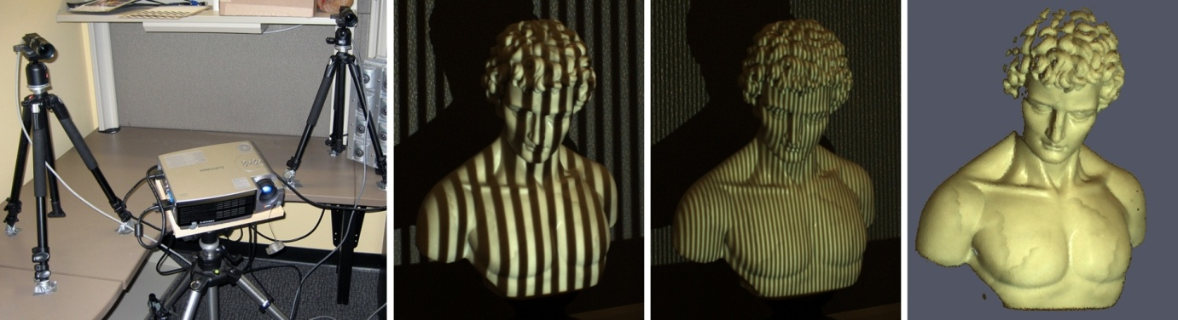
Structured Lighting Approach
A Light pattern is projected on to a set of objects.
Using the distortion of the pattern the shape of the obstacle is determined.
Inflection indicates a curved surface, break indicates a gap between surfaces etc.
Notes:
i

Slide 42
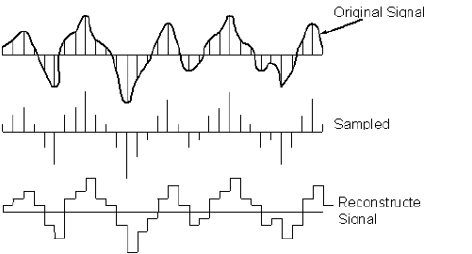
Analog to Digital Conversion
The analog voltage signal is converted into a voltage signal that can be stored in a computer memory.
Sampling
It is the periodic collection of data from the source to create a discrete time analog signals.
Quantization
Process of assigning a finite number of defined amplitude levels. (Amplitude levels correspond to a grey scale used in the system)
Encoding
Process of representing an amplitude level by a binary digit sequence.

Slide 43
Image Processing and Analysis
Image data reduction – Reduction of the volume of data.
Digital Conversion – reduction of the number of gray levels
Windowing – using only a portion of the image for processing
Segmentation – Grouping areas of similar characteristics
Thresholding – Conversion of a pixel to a binary value
Region growing – grouping pixels into regions called grid elements
Edge detection
Feature Extraction – Extracting features that will help in recognizing the object
Object Recognition
Template Matching Techniques
Structural Techniques

Slide 44
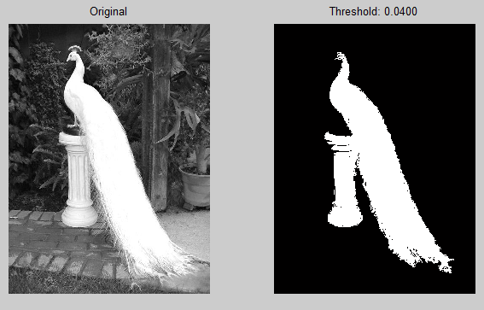

Image Processing and Analysis
Segmentation – Grouping areas of similar characteristics
Thresholding – Conversion of a pixel to a binary value
Region growing – grouping pixels into regions called grid elements
Edge detection
Example of Thresholding

Slide 45
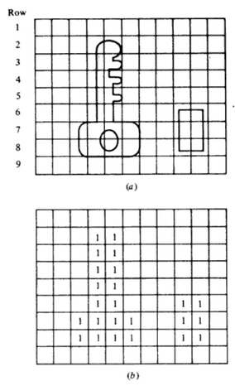
Image Segmentation
Region Growing
a Image with grid
b segmented image

Slide 46
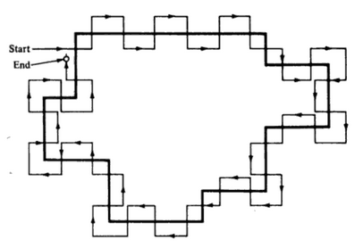
Edge Detection
Edge following procedure to detect the edge of a binary image.

Slide 47
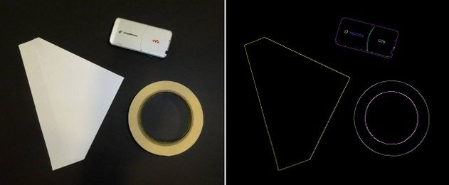
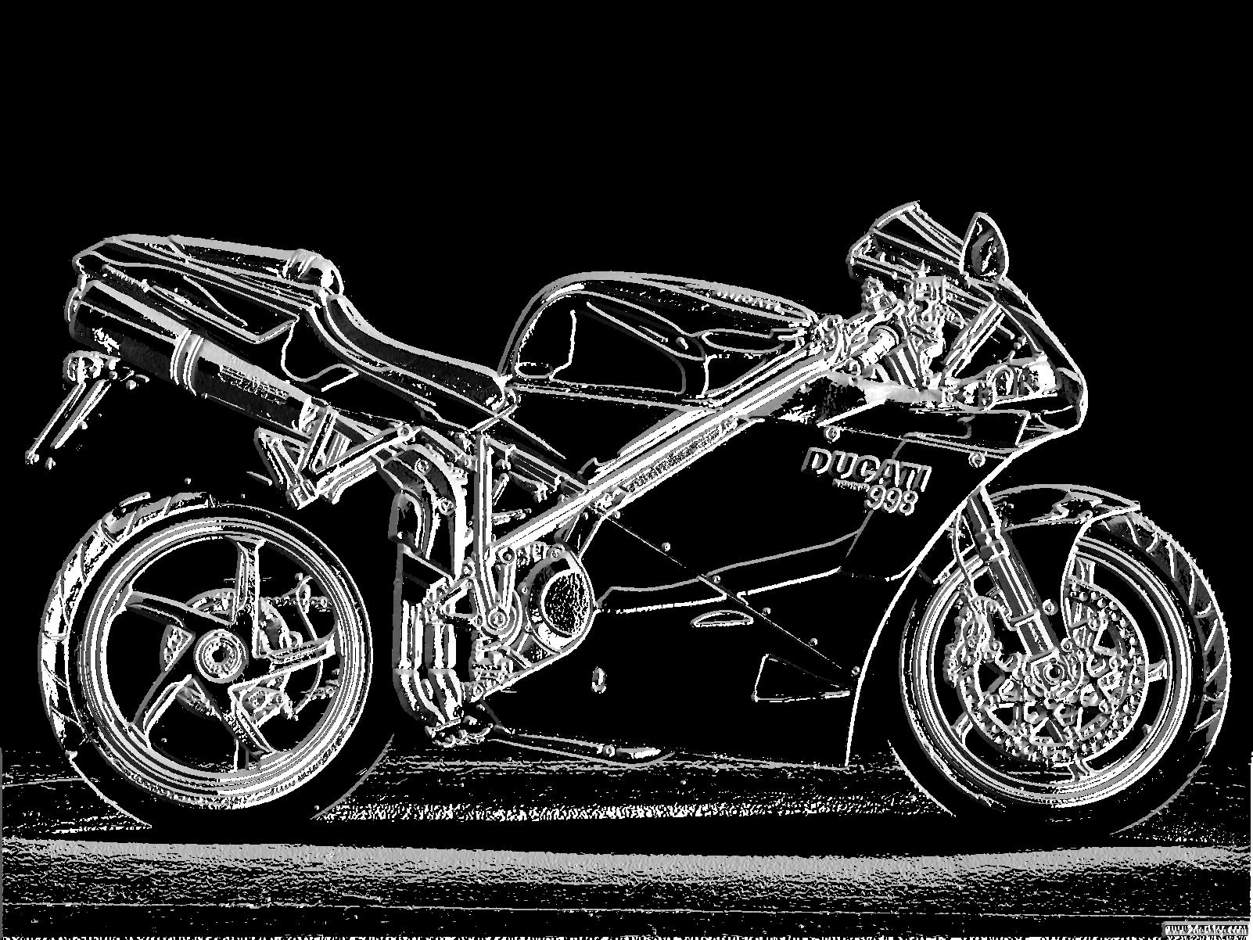
Edge Detection

Slide 48
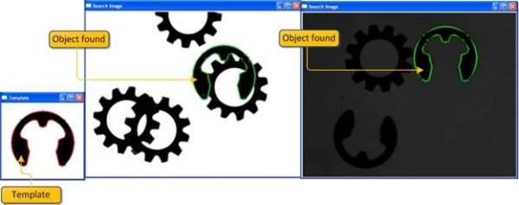
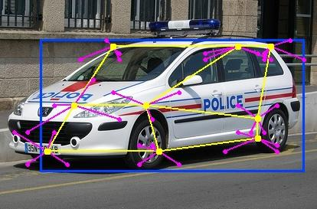
Object Recognition
Template Matching
Structural Method

Slide 49
Expectations
Vision-based guidance of the robotic arm
Complex inspection of close dimensional tolerances
Improved Recognition
Part Location capabilities
Expected Applications:
Photo interpretation (the science of identifying and describing objects in photographs )
Cartography (Study and practice of making maps)
Manufacturing
Warehousing
Robotic operations in hazardous environments
Autonomous navigation
Medical image analysis

Slide 50
THANK YOU
The presenter is grateful to the authors of the following textbooks.
Industrial Robotics - Mikell P. Groover
Fundamentals of Robotics – Robert Schilling
Industrial Robotics Wesley Snyder

